Slide 1
Downloading XL Data Analyst
2341 Marketing Research
PC Lab Week 8

Slide 2
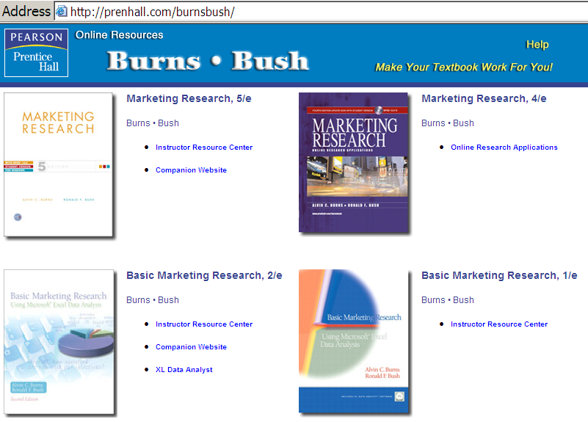
Step 1. Go to Text Website
Go to http://prenhall.com/burnsbush
Find the text: Basic Marketing Research 2/e and click on XL Data Analyst.
Click on
XL Data Analyst

Slide 3
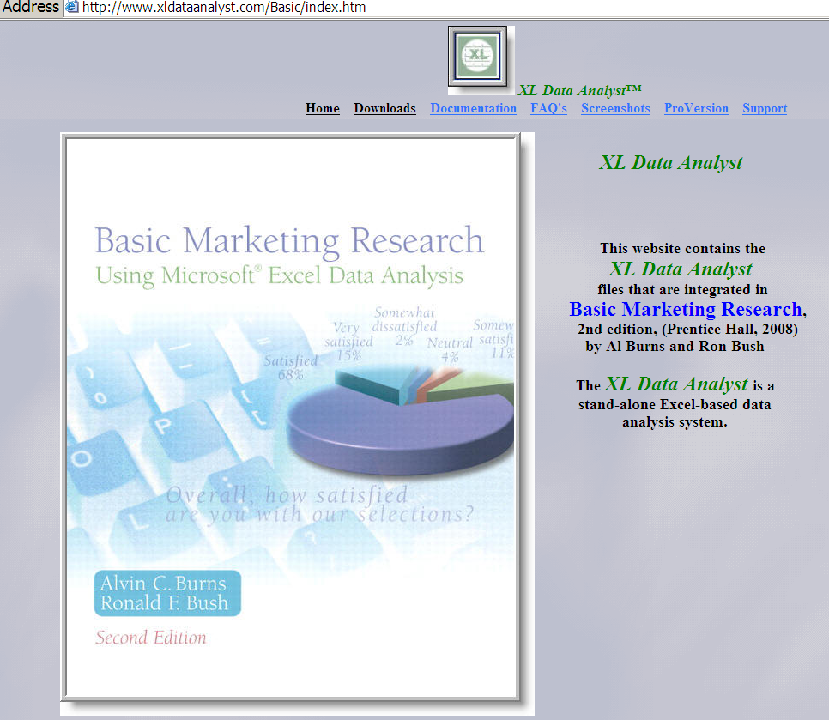
Step 2. Click Downloads
Click on Downloads

Slide 4
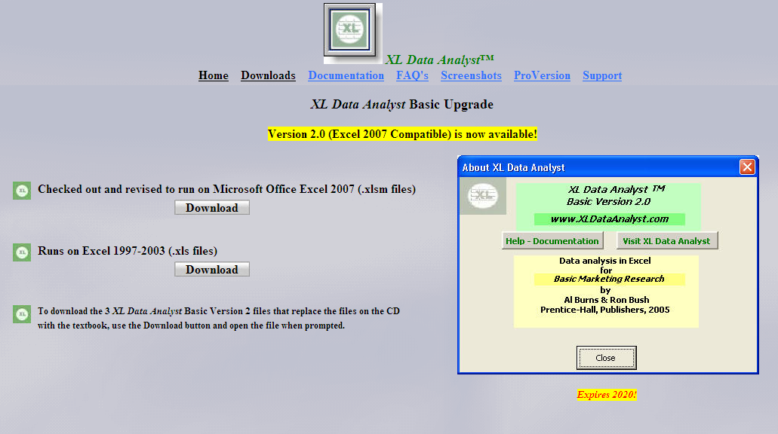
Step 3. Download XLDA Version 2003 or 2007
Choose Version
2003 or 2007
Click Download

Slide 5
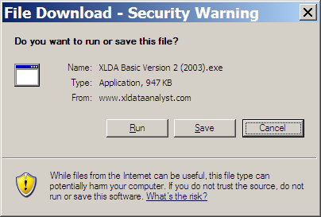
Step 3. Download XLDA
A security warning pops up. Click Save.
This will save a zip file to your disc.
The file will be saved to C: drive.

Slide 6
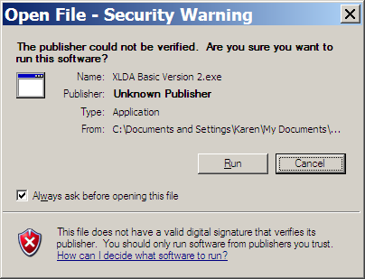
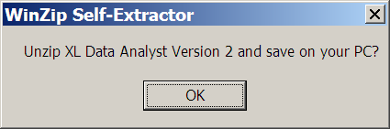
Un-zip XLDA File
In Windows Explorer double click on the Zip file.
A security warning pops up. Click Run.
You are asked if you want to save the file. Click OK.

Slide 7
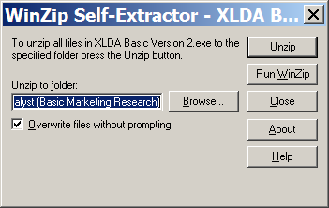
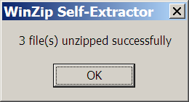
Un-zip XLDA File
Click Unzip.
A message tells you 3 files unzipped successfully. Click OK.
Click Close.

Slide 8
Step 4: Open XLDA Files
You are now ready to open the XLDA files.
If you have Excel 2003 follow Step 4A.
If you have Excel 2007 follow Step 4B.

Slide 9
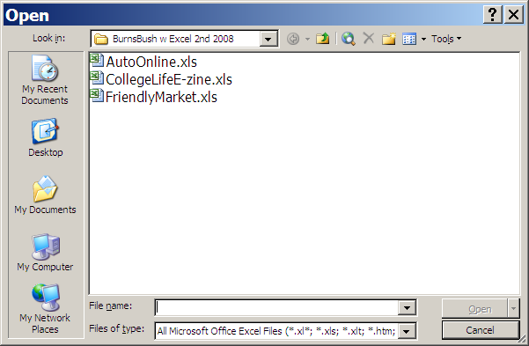
Step 4A: Open XLDA Files - 2003
You have now downloaded the XL Data Analyst macros plus 3 data files.
Open Excel.
Click File – Open and find the data files.
You should see 3 spreadsheet files.
Open the file CollegeLifeE-zine.

Slide 10
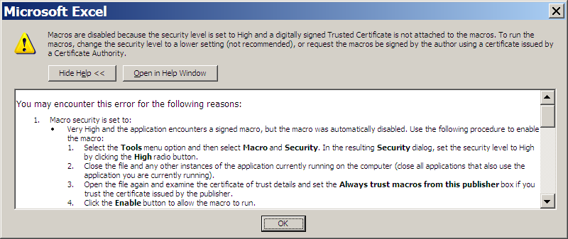
Step 4A: Open XLDA Files - 2003
XL Data Analyst is a set of macros so you need to set the security to allow those macros and the XL Data Analyst menu.
If you have not set the security to medium or low, the macros will be disabled.

Slide 11
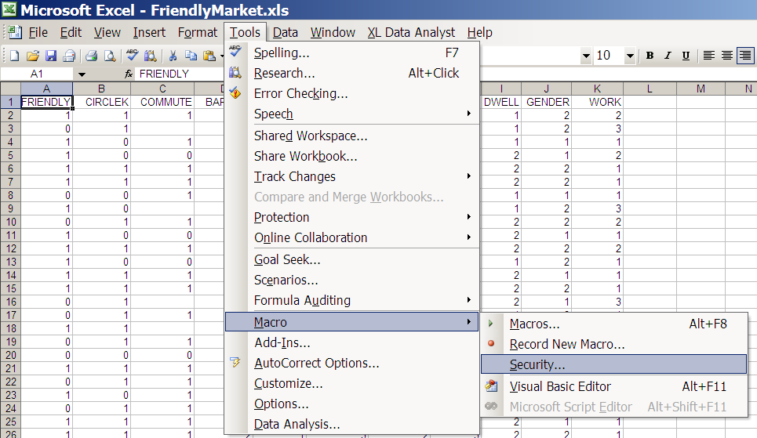
Step 4A: Open XLDA Files - 2003
To allow the macros in Excel 2003, set the security at Medium or Low:
Click Tools – Macros – Security

Slide 12
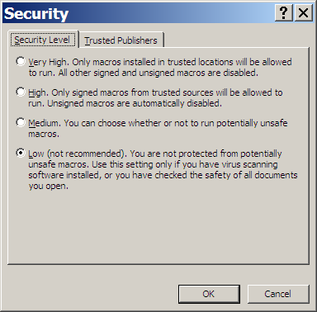
Step 4A: Open XLDA Files - 2003
Check Medium or Low.
You may then have to check Enable Macros.

Slide 13
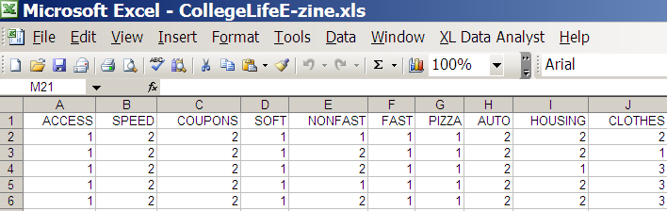
Step 4A: Open XLDA Files - 2003
Notice that XL Data Analyst is now on the taskbar.
Note: If the Macros are not enables you can not see the XLDA Menu.

Slide 14
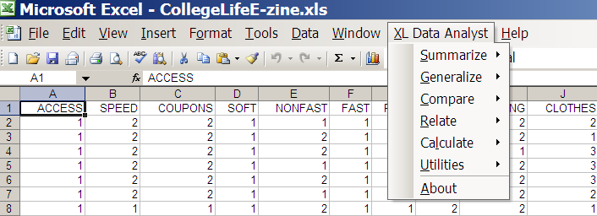
Step 4A: Open XLDA Files - 2003
To see the pull-down menu, click on XL Data Analyst.

Slide 15
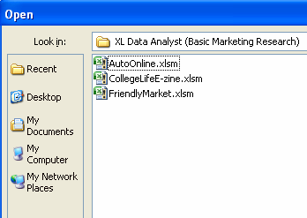
Step 4B: Open XLDA Files - 2007
You have now downloaded the XL Data Analyst macros plus 3 data files.
Open Excel.
Click File – Open and find the data files.
You should see 3 spreadsheet files.
Open the file CollegeLifeE-zine.

Slide 16
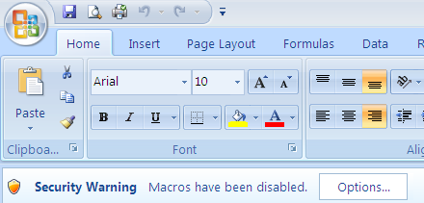
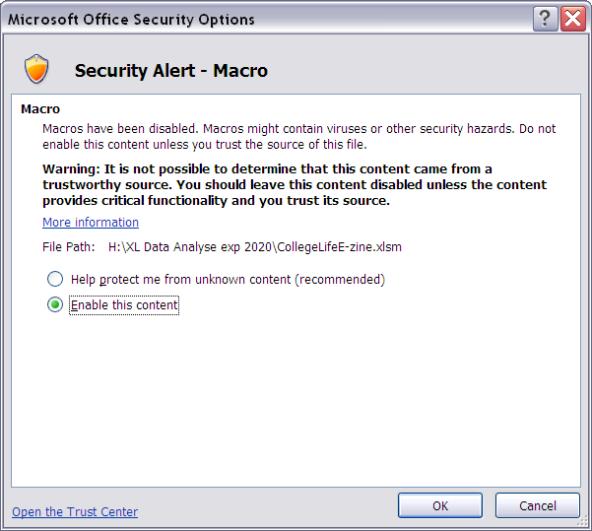
Step 4B: Open XLDA Files - 2007
XL Data Analyst is a set of macros so you need to set the security to allow those macros and the XL Data Analyst menu.
Click Options.
Check Enable Content.
MKTG2309-08 PCLab 8
16

Slide 17
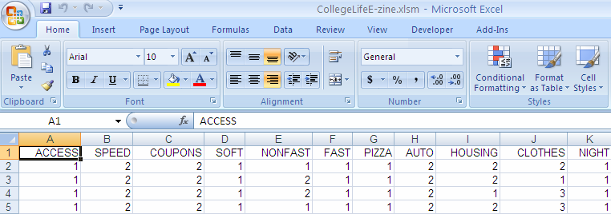
Step 4B: Open XLDA Files - 2007
Notice that you now have Add-Ins on the taskbar.
Note: If the Macros are not enables you can not see the XLDA Menu.

Slide 18
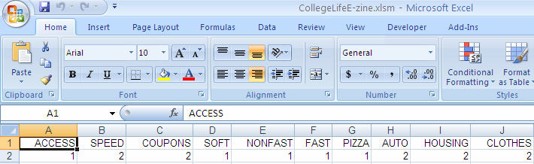
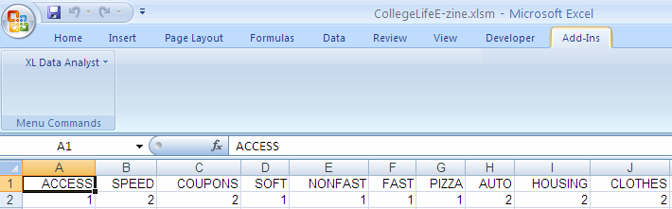
Step 4B: Open XLDA Files - 2007
Notice a new tab ‘Add-Ins’ is now on the taskbar.
Click on the Add-Ins Tab to see XL Data Analyst.

Slide 19
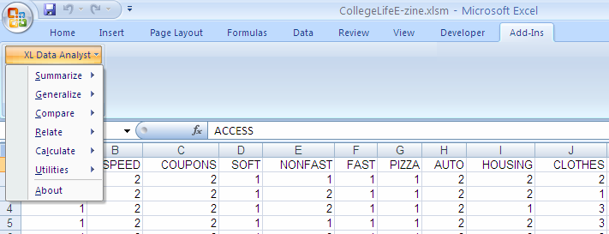
Step 4B: Open XLDA Files - 2007
To see the pull-down menu click on XL Data Analyst.

